Slide 2
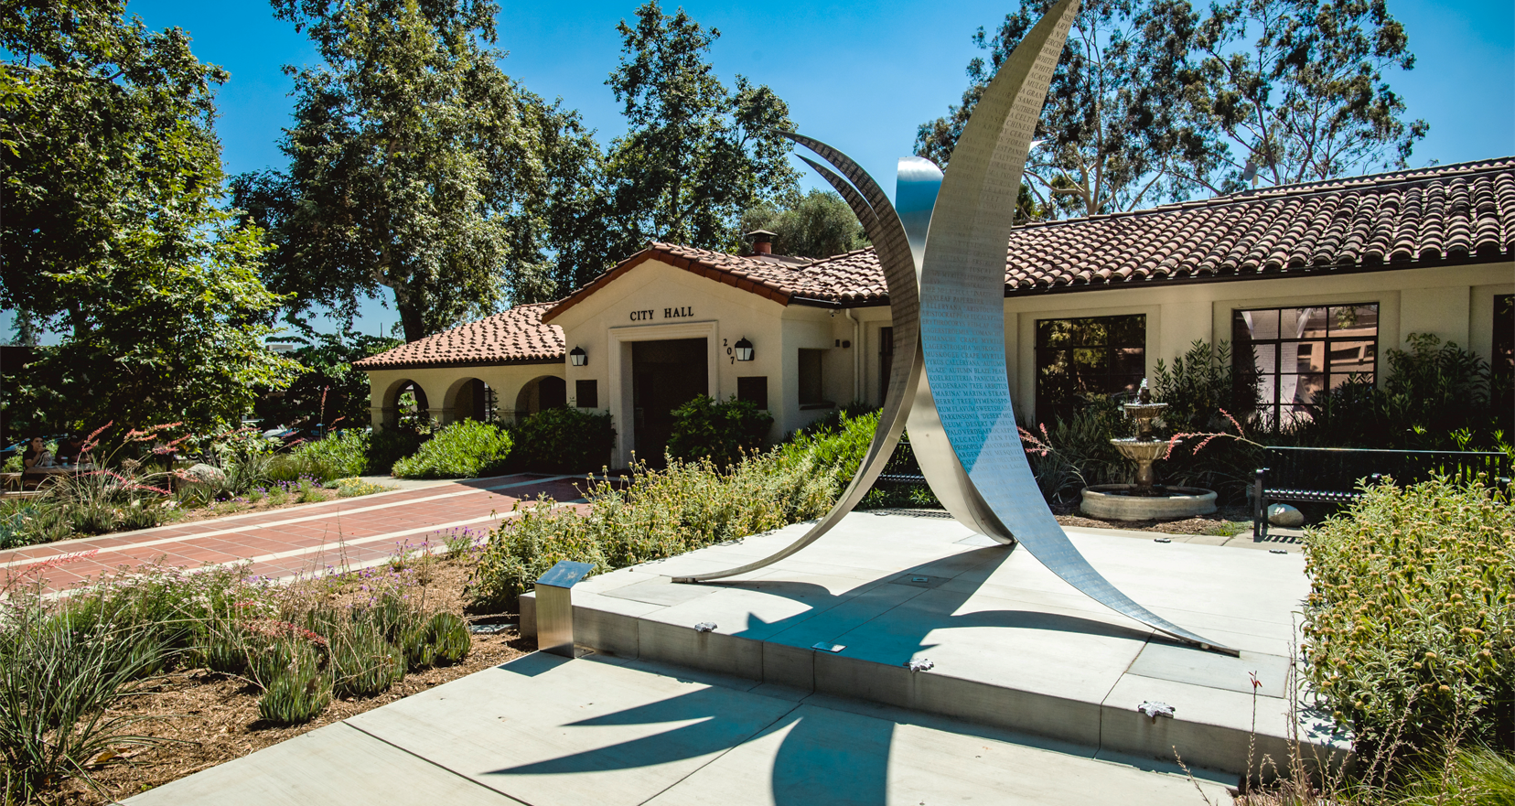
CLAREMONT CITY COUNCIL SPECIAL MEETING
Wildfire Preparedness Workshop
MARCH 1, 2025
9:00 AM

Slide 3
CALL TO ORDER THE SPECIAL MEETING OF THE CLAREMONT CITY COUNCIL
Chamber of Commerce | September 14, 2022
3

Slide 4
PLEDGE OF ALLEGIANCE
Chamber of Commerce | September 14, 2022
4

Slide 5
ROLL CALL
Chamber of Commerce | September 14, 2022
5

Slide 6
WILDFIRE PREPAREDNESS COMMUNITY WORKSHOP
Presentations will be followed by community comments and questions. Following a short recess, staff will return to provide information on comments/questions received, and the City Council will provide remarks.
Chamber of Commerce | September 14, 2022
6

Slide 7
INTRODUCTION OF CITY STAFF & REPRESENTATIVES FROM PARTNER AGENCIES City Manager Adam Pirrie
Chamber of Commerce | September 14, 2022
7

Slide 8
Acting Captain Robert Ewing Claremont Police Department
Chamber of Commerce | September 14, 2022
8

Slide 9
Overview
While the City’s response will depend on the type of emergency, the following steps are generally taken to address an emergency as it unfolds:
The City activates its Emergency Operations Center (EOC)
The City determines appropriate staffing levels and resources needed to respond to the emergency
Information and updates will frequently be shared by the City to the community (emergency communications/alerts)
Mutual aid will be requested if needed
Chamber of Commerce | September 14, 2022
9

Slide 10
Emergency Preparedness
The City of Claremont and the Claremont Police Department encourage residents and business owners to prepare for all emergencies.
Emergencies and critical events may include man-made incidents or natural disasters.
The most prominent threats to our area include Earthquake, Wildland fires, and severe weather.
Resources for personal emergency preparedness are available online and in the foyer (flyers).
Chamber of Commerce | September 14, 2022
10

Slide 11
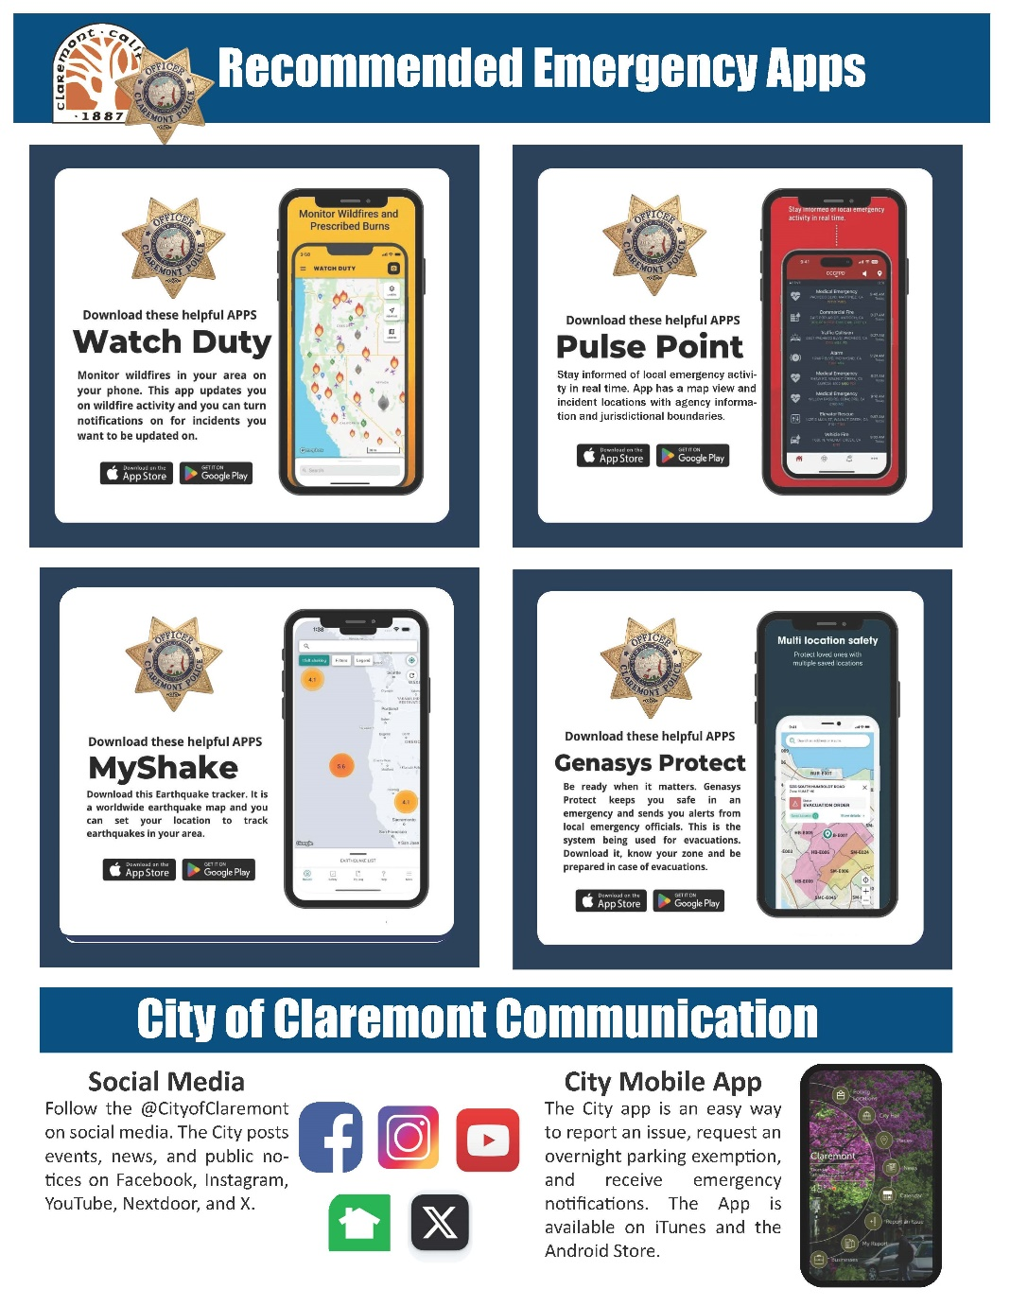
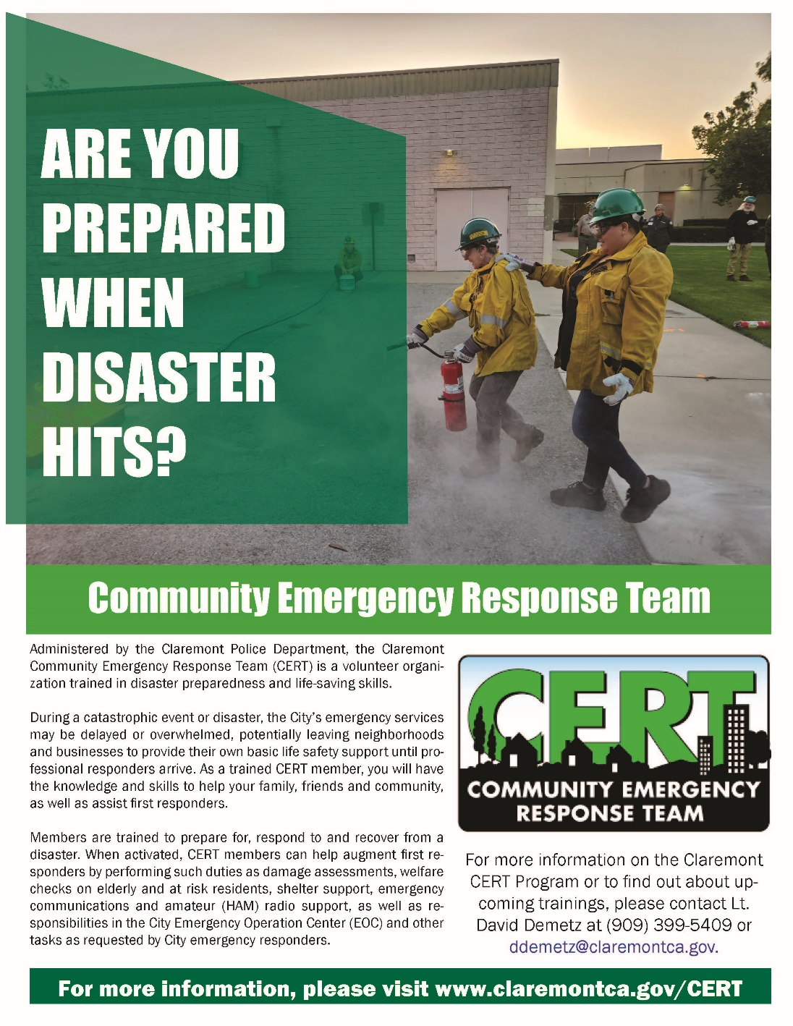
Chamber of Commerce | September 14, 2022
11

Slide 12
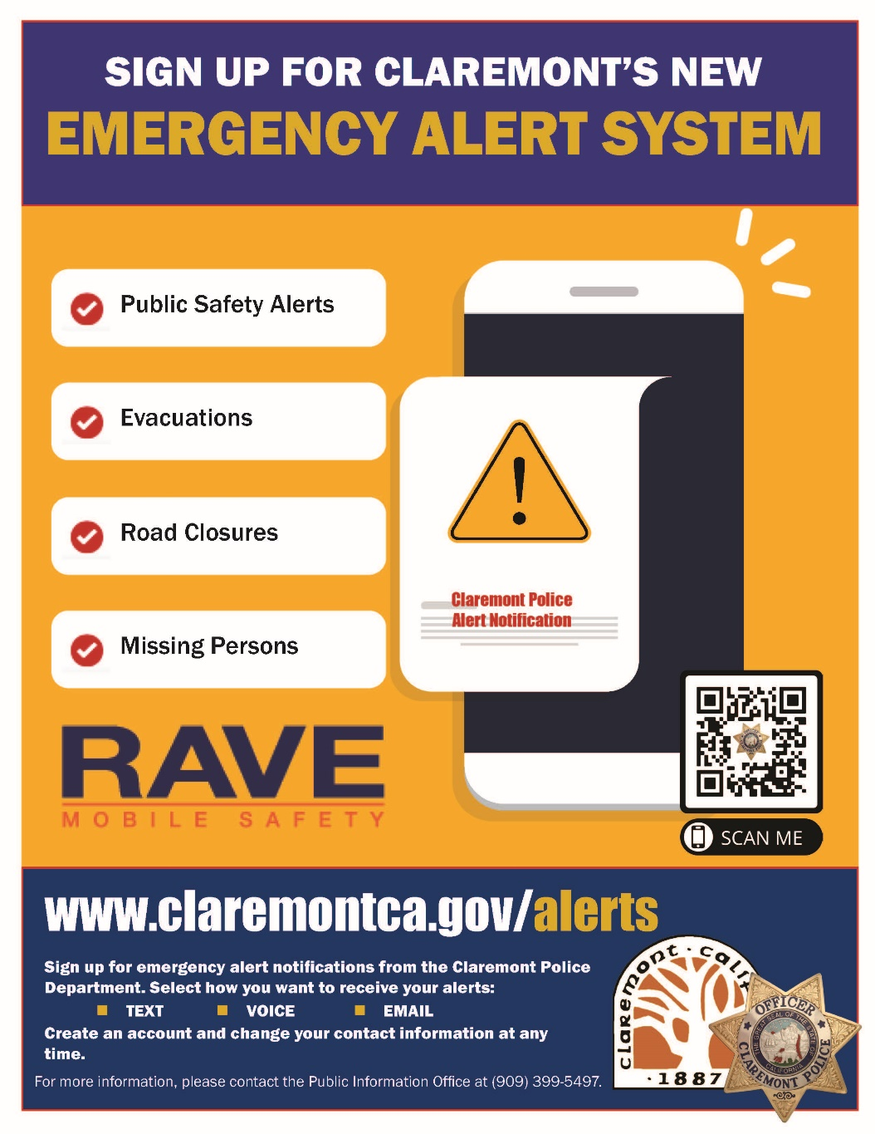
Chamber of Commerce | September 14, 2022
12

Slide 13
There are additional handouts available to take home in the foyer, including…
Emergency Preparedness Guide for Older Adults, Individuals with Disabilities, and People with Access and Functional Needs
City Communication Flyer
FAQ about 2020 Fire Hazard Severity Zones (CAL FIRE)
Information from partner agencies
Chamber of Commerce | September 14, 2022
13

Slide 14
Battalion Chief Noble Robinson LACoFD
Chamber of Commerce | September 14, 2022
14

Slide 15
The Ready, Set, Go! Personal Wildfire Action Plan gives you the tips and tools you need to successfully prepare for a wildfire.
Ready, Set, Go! will help you protect yourself, your family, and your property from a devastating wildfire.

Slide 16
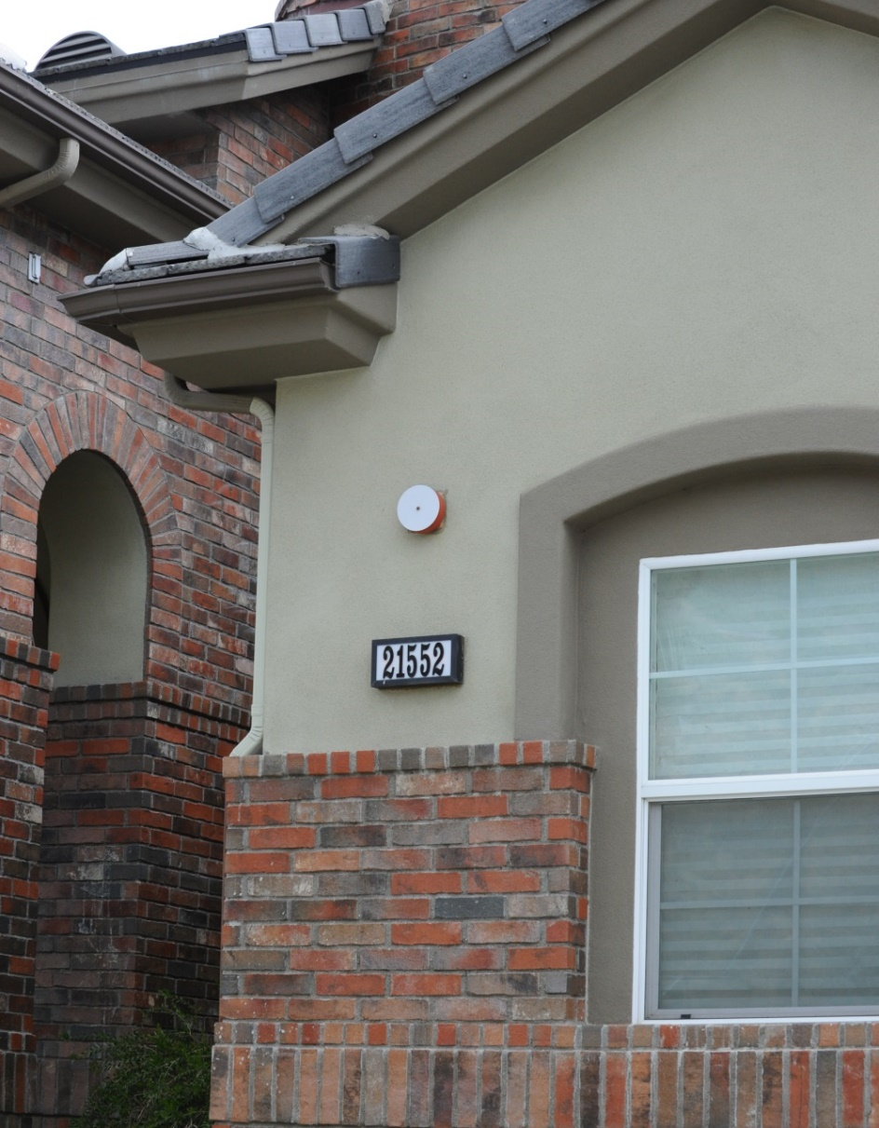
GET READY Home Hardening What is a “Hardened” Home?
A “Hardened Home” is a structure that is not receptive to ignition from embers. This will give your home the best chance of surviving a wildfire.
Notes:
Get your home READY with Home hardening
Always start at the house and work your way out. Your house is most susceptible to ignition from embers – If your home it is not hardened during the wind driven fire - embers can find its way on or in your house and ignite it
WE have Four home hardening categories we will look at
1 Roof and Rain Gutters
2 Ember entry points
3 Hazards within 5 feet – the critical zone Focus on hardening of the home then work your way out.
4 Defensible space beyond 5 feet
The more proactive you are with your hardening of your home and defensible space. Then more you improve the chances of your home surviving a wildfire

Slide 17
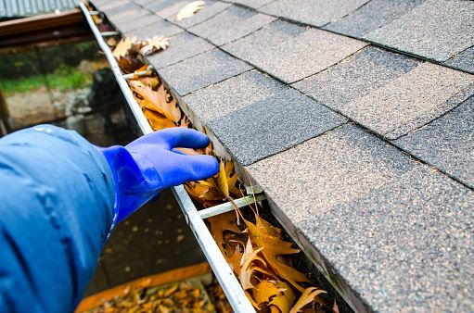
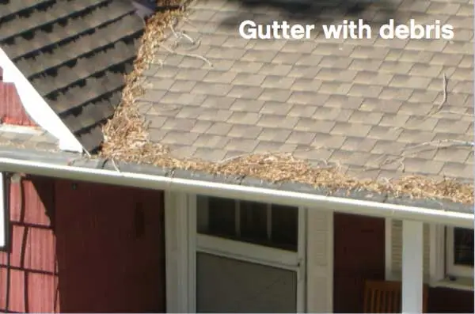
Roof and Rain Gutters
Class A roof – Asphalt, cement, metal, and clay shingles. NOT wood shingles.
Check for any crack or gaps in roof where embers could get in.
Cleanliness of roof is important. Clean channels crevasses nooks and crannies. Free of debris, leaf liter, and pine needles
Rain gutters – inspect and clean, remove any ignitable material
Inspect annually and often. Recommended before summer and after wind events.
Notes:
Your roof is one of the largest parts of your home, so it poses one of the greatest risks to ember cast fires.
Class A roof – Asphalt, cement, metal, and clay shingles. NOT wood shingles.
Check for any crack or gaps in roof where embers could get in.
Cleanliness of roof is important. Clean channels crevasses nooks and crannies. Free of debris, leaf liter, and pine needles
Rain gutters – inspect and clean, remove any ignitable material
Inspect annually and often. Recommended before summer and before and after wind events.

Slide 18
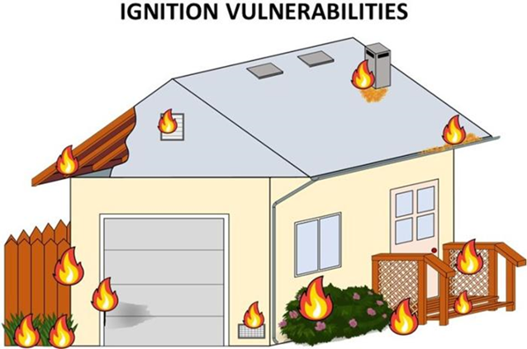
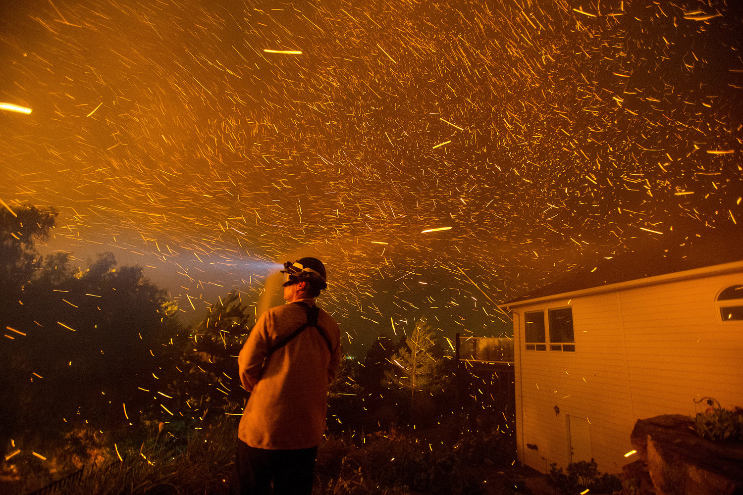
GET READY
Ember Entry Points
There are many ember entry points we can fortify.
Windows
Exterior doors
Garage doors
Chimneys
Open eaves
Vents
Notes:
Ember entry points we can fortify
Windows – Exterior Doors – Garage Doors – Chimneys –Open Eaves – Vents
Once again think about those NWS warnings of Red Flag or High wind – We typically have a good lead time the events are forecasted a week in advance - take extra time to go around your house and Batton down the hatches as they would say in Hurricane country. If we get an ignition during these Red Flag Warnings – we will have a fast-moving Ember Cast Wind Driven Fire, and these fast-moving dangerous fires is what we will be preparing for.
-----So lets take a look at --

Slide 19
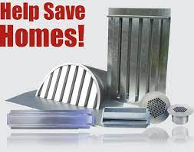
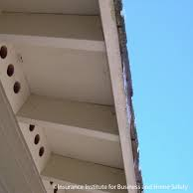
Vents
Vents – Locate all vents, Dormer and ridge vents (roof), Attic vents, gable vents , under eves, crawl space.
These vents are usually covered with a ¼ inch screen. You will want to upgrade to a 1/8 inch or smaller metal screen or prefabricated spark resistant cover with grates and baffles to maximize protection against ember intrusion.
No need to remove old screens you can in most cases add to the existing vent cover extra screen or bolt new cover over old one.
Notes:
Vents – Locate all vents, Dormer and ridge vents (roof) Attic vents, gable vents , under eves, crawl space.
After market Vent Covers with Luvers and fine mesh screens can be purchased. There are some Ember resistant style vents that can be found online. Some work for retro fit and some new construction

Slide 20
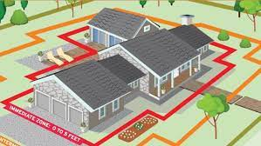
GET READY 0 – 5 Feet
Keep it lean, clean and green.
Get vegetation away from the structure, clean up any dead and down trees.
Many plants look green on the outside but have dead material inside and underneath susceptible to embers and can easily ignite.
Its all about maintenance. If its highly combustible keep out of 0-5
Attachments to the Home - Fences, Decks, Arbors. Can be a hazard.
If attached to the home keep clean of vegetation and collect no debris. Keep maintained with calked and sealed and noncombustible.
Use metal flashing against structures and attachments where embers could land.
Trees not touching roof, 10 feet from roof line.
Notes:
It is important to remove all combustible materials that are in the 0-5 boundary of your home.
Firewood, outdoor furniture, wood mulch, combustible vegetation, debris or litter. If these things catch fire and are in this zone, fire will likely spread.

Slide 21
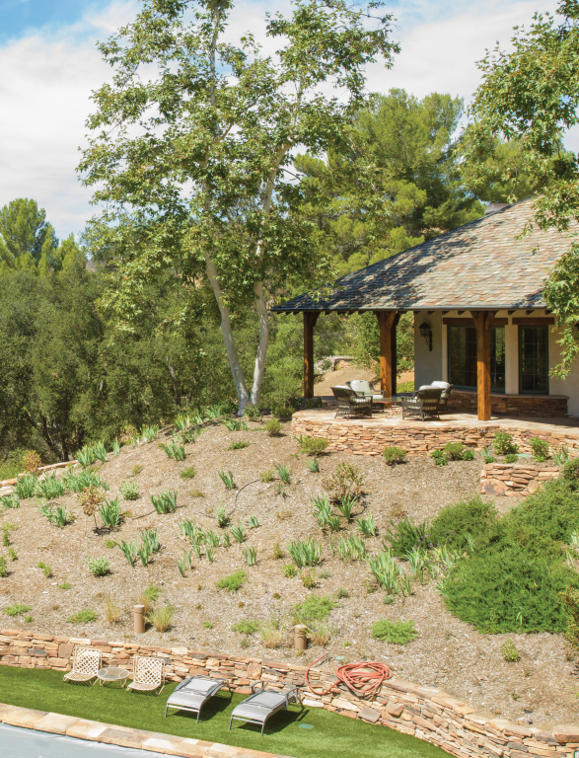
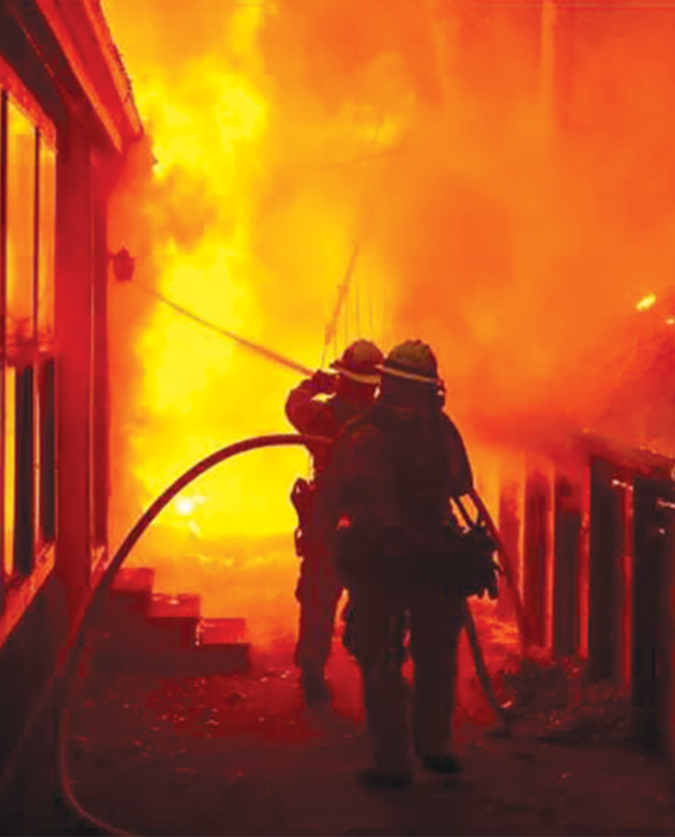
Get READY – Create a Defensible Home
Defensible Space
Creating and maintaining defensible space is essential for increasing your home's chance of surviving a wildfire
Notes:
Within this zone we have found the first 5 feet to be very important. Keep it clean and Free of any combustible material. As embers land on and against the structure they could ignite and once they are on fire it can easily spread to the structure.
■ If we have embers landing in this zone that is why it’s important to remove all combustible items that 0-30 from the boundary of your home. Fire wood, outdoor furniture, dead or dry vegetation, animal housing – if up against the house could ignite from embers and catch your home on fire – Keep it Clean and free of any ignitable material. If there is vegetation in zone 1 it needs to be clean, lean and green free of debris or liter, away from the structure and have good spacing.
■ Fences and decks in this zone can also be a hazard if they are built from combustible material and are attached to your home. Make sure decks are clean of vegetation and combustible material is caulked and sealed with no areas to collect debris. Even tree branches touching or hanging over the roof line can become fire starters. You’ll want to try and keep these at least 10 feet away from the home and roofline.
■ Propane tanks need to be clear and free of ignitable material Also consider how you store your portable propane tanks, where you park your vehicles or stow other equipment such as lawnmowers or landscaping equipment in secure area.
■ •Cut or mow annual grass down to a maximum height of three inches.
■ •Trim trees regularly to keep branches a minimum of 10 feet from other trees.
■ •Create separations between trees, shrubs, and items that could catch fire, such as patio furniture, swing sets, etc.
■ •Irrigation is recommended to maintain vegetation moisture content.
■ •Create vertical and horizontal spacing between trees and shrubs (the distance between trees should be three times the height).
■ •Irrigation is recommended to maintain vegetation moisture content, this will help keep it lean clean and green.

Slide 22
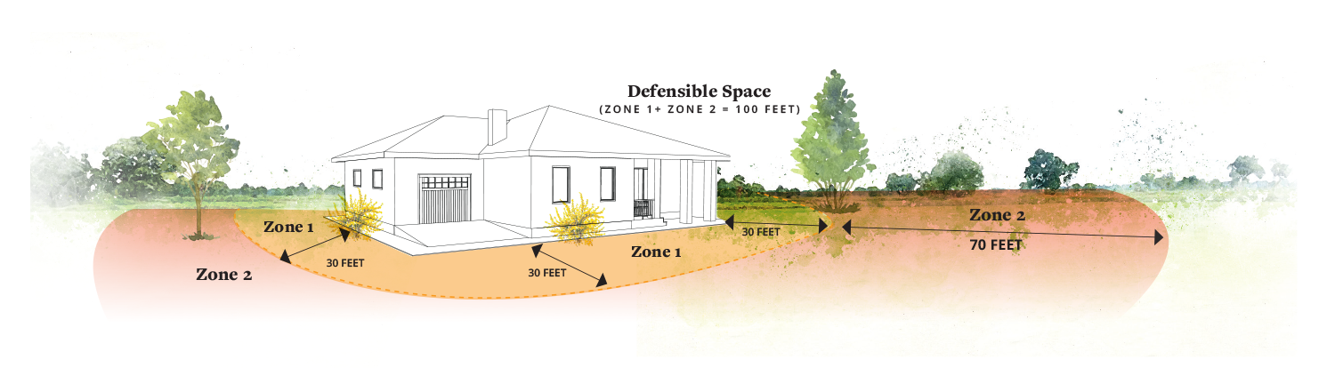
Defensible Space
Zone 1 – Remove all flammable vegetation or combustible growth within 30 feet from any structure or 50 feet of any structure in high-hazard areas.
Zone 2 – Clear vegetation an additional 70 feet from the structure, for a total of 100 feet. (Note: An inspector may require clearing an additional 100 feet.)
Notes:
Defensible space is the area around a structure free of flammable plants and objects.
This space creates a zone in which firefighters can operate safely in order to protect your home.
The space is wide enough to also prevent flames and heat from setting your home on fire.
Within this zone we have found the first 5 feet to be very important. Keep it clean and Free of any combustible material. As embers land on and against the structure they could ignite and once they are on fire it can easily spread to the structure.
■ If we have embers landing in this zone that is why it’s important to remove all combustible items that 0-30 from the boundary of your home. Fire wood, outdoor furniture, dead or dry vegetation, animal housing – if up against the house could ignite from embers and catch your home on fire – Keep it Clean and free of any ignitable material. If there is vegetation in zone 1 it needs to be clean, lean and green free of debris or liter, away from the structure and have good spacing.
■ Fences and decks in this zone can also be a hazard if they are built from combustible material and are attached to your home. Make sure decks are clean of vegetation and combustible material is caulked and sealed with no areas to collect debris. Even tree branches touching or hanging over the roof line can become fire starters. You’ll want to try and keep these at least 10 feet away from the home and roofline.
■ Propane tanks need to be clear and free of ignitable material Also consider how you store your portable propane tanks, where you park your vehicles or stow other equipment such as lawnmowers or landscaping equipment in secure area.
■ •Cut or mow annual grass down to a maximum height of three inches.
■ •Trim trees regularly to keep branches a minimum of 10 feet from other trees.
■ •Create separations between trees, shrubs, and items that could catch fire, such as patio furniture, swing sets, etc.
■ •Irrigation is recommended to maintain vegetation moisture content.
■ •Create vertical and horizontal spacing between trees and shrubs (the distance between trees should be three times the height).
■ •Irrigation is recommended to maintain vegetation moisture content, this will help keep it lean clean and green.

Slide 23
0-30 Feet and Beyond
Creating defensible space improves the chances of your home serving a wildfire.
Proper spacing on your property creates less fuel continuity and slow the rate of spread of the fire with less flame intensity.
Defensible zone is all about maintenance.
Weed whip areas with dried out weeds; keep plants spaced and clean; and green free of dead materials that could easily ignite.
Notes:
Zone 2 is a mosaic landscape – This Proper spacing on your property creates less fuel continuity and slow the rate of spread of the fire with less flame intensity
• Defensible zone is all about maintenance.
Continue in Zone 2 to Weed whip areas with dried out weeds keep plants spaced and clean and green free of dead materials that could easily ignite.
*Cut or mow annual grass down to a maximum height of three inches.
• Create vertical and horizontal spacing between trees and shrubs (the distance between trees should be
three times the height).
• Remove fallen leaves, needles, twigs, bark, cones, and small branches. However, a mulch layer may be permitted to a depth of four inches, if erosion control is an issue.
• Irrigation is recommended to maintain vegetation moisture content.

Slide 24
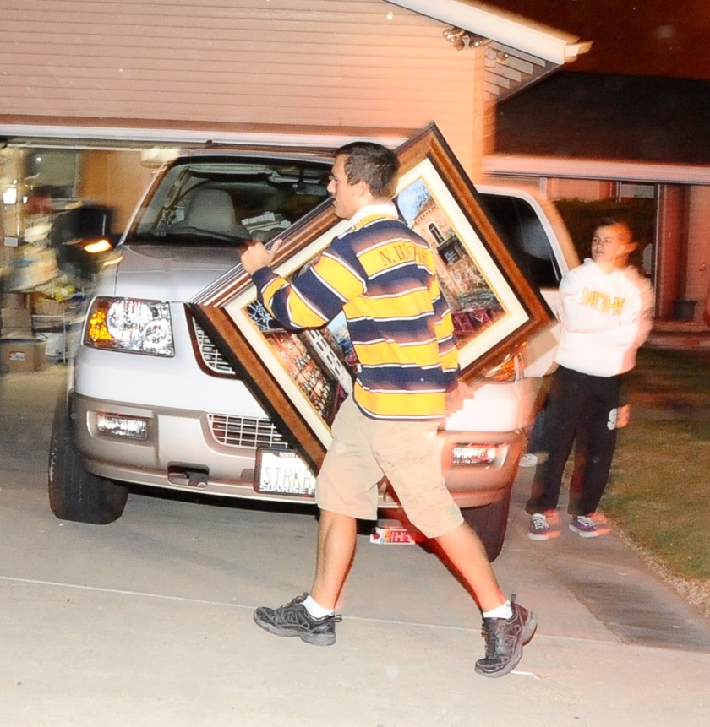
Get SET – Prepare Your Family
Prepare your Wildfire Action Plan with all members of your household well in advance of a fire.
Use the Ready, Set, Go! checklists to create your plan.
Rehearse your plan regularly with your family and keep it safe and easily accessible.
Notes:
Pack up important papers, photo albums, sentimental keepsakes, so they are all together in one place. Store this box/bin in a location where it will be easily accessible in the event you need to evacuate quickly.
Make a list of locations of items most important to take with you.

Slide 25
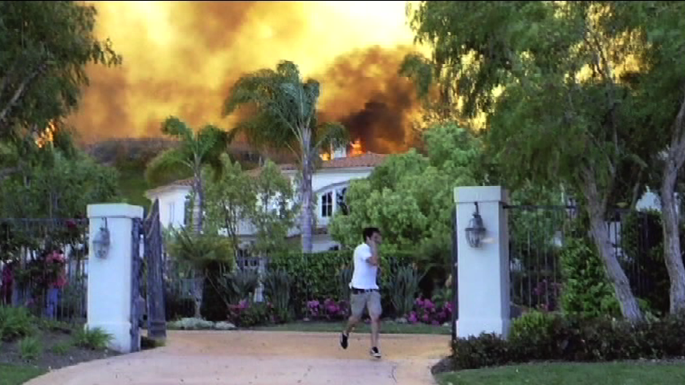
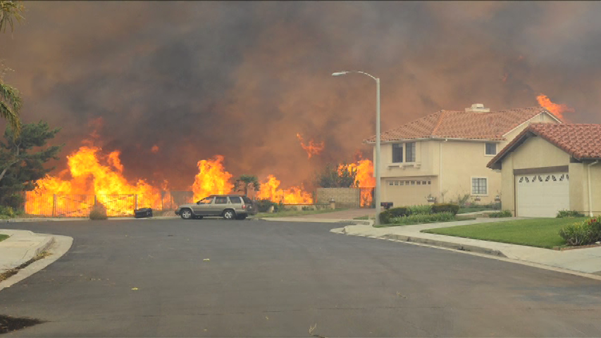
Go Early
Leaving early gives your family the best chance of surviving a wildfire!
Notes:
The Los Angeles County Fire Department must decide where to strategically deploy resources ahead of the fire front, and immediately initiate appropriate evacuation procedures.
You do not have to wait for the order to evacuate.
Leaving early keeps roads clear, enabling firefighters to do their job
Make an emergency kit.
Be ready for an immediate evacuation.
If you are evacuated, leave to a predetermined location.
Have several travel routes in case one route is blocked by fire or emergency vehicles and equipment.

Slide 26
For More Information
http://www.fire.lacounty.gov
LACoFD Public Information Office: (323) 881-2411
Headquarters Address
1320 N. Eastern Avenue
Los Angeles, CA 90063
Notes:
BE PREPARED Ready, Set, Go
Home hardening, Defensible space, Evacuation plans
This will give you and your home the best chance of surviving a wildfire.
Our web site fire.lacounty.gov has more information on defensible space and ready set go

Slide 27
Disaster Management Area Coordinator Diana Manzano-Garcia Area D Office of Disaster Management
Chamber of Commerce | September 14, 2022
27

Slide 28
Diana Manzano-Garcia

Slide 29
Disaster Management Area Coordinator
Serve the 23 cities in the East San Gabriel Pomona Valley
Joint Power Authority between the cities
Serve as a Liaison between the Cities, County, State and Federal partners
Coordinate with local governments Emergency Services Coordinator or designee

Slide 30
What does Area D do?
Responsible to carry out the Mission of our Area through:
Program delivery
Members support
Outside agency partnerships
Communication at all levels
Disseminate EM information received from the OA
Assist in SEMS/NIMS Compliance- Planning, Training, Exercise
Conduct workshops
Host monthly meetings
Facilitate information flow

Slide 31
Coordinated Response
The response begins at the local (city) level:
Act as an advisor
Assist in assessing the need for resources
Relay needs of the city to the OA
Guidance to ensure continuity of government
Ensure public information is available to the cities and partner agencies
Check in with Area cities to quickly determine the impact of the emergency/disaster
Provide a quick Area status to the Operational Area
Coordinate any unmet needs with our County EOC

Slide 32
Regional Public Affairs Manager Marissa Castro-Salvati Southern California Edison
Chamber of Commerce | September 14, 2022
32

Slide 33
Foothill District General Manager Ben Lewis Golden State Water Company
Chamber of Commerce | September 14, 2022
33

Slide 34
Page 01
Golden State Water Company
Fire Preparedness & Mitigation

Slide 35
Golden State Water Company: Overview
Page 02
Delivering quality, reliable water to more than 1 million people in over 80 communities throughout California for more than 90 years.

Slide 36
Page 03
Proudly serving the Wrightwood community since 1976.
Serve approximately 4,100 customers with quality and reliable drinking water.
Customer safety is our
top priority.
Wrightwood
Significant investment in Emergency Management and Fire Prevention.
In September 2024, Golden State Water responded and supported the community during the Bridge Fire.

Slide 37
Page 04
Bridge Fire Timeline
September 8
September 10
September 11
September 14
September 17
Fire begins
Mandatory evacuations
Do Not Drink (DND) order issued
Do Not Drink (DND) order lifted
Mandatory evacuations lifted

Slide 38
Page 05
Successes

Slide 39
Page 06
Communication and Coordination ​
Effective Communications
Customers
GEMS Messages
(Phone, email & text messages)
First Responders
Remote Base Ops​
County Coordination Calls
Media Outlets​
Accurate Messaging

Slide 40
Page 07
Emergency Preparedness & Response​
All-Hazards Emergency Preparedness & Response Plan (updated yearly). ​
NIMS/SEMS and the Incident Command System when responding to emergencies so that we can easily integrate with first responders. ​
Emergency preparedness training throughout the year.​
Involved with various emergency management organizations. ​

Slide 41
Page 08
Emergency Preparedness & Response​
Resources can be pulled from other areas of the company.​
Contractors and vendors to support immediate needs.​
A member of:​
The California Water/Wastewater Agency Response Network (CalWARN)​
California Utility Emergency Association (CUEA)

Slide 42
Page 9
Investments in Fire Hardening​
Concrete barriers surrounding critical supply and water pumps
Vegetation management
Proactively investing in replacing aging infrastructure.
Emergency generators to ensure water service is not disrupted during a power outage
Zone of defensible space around our facilities

Slide 43
Fire Prevention and Mitigation​
Page 10

Slide 44
Customer Communications
Page 11
Customers will be notified by phone, text or email on the status of their water, water system and safety. Emergency information is also posted on the GSWC website and social media platforms.
The GSWC customer service center is open 24/7, seven days a week, to address customer questions and respond to emergencies. ​
Customers can reach us at 1(800) 999-4033.
Customer Safety is Our Top Priority ​
We encourage customers to make sure their contact information is up to date, including email addresses and mobile/home telephone numbers.
To update contact information and access the Customer Alerts and Notification page, visit:
gswater.com/emergency-preparedness.

Slide 45
Page 12
Thank You!

Slide 46
Public Affairs Manager Jessica Alvarenga SoCalGas
Chamber of Commerce | September 14, 2022
46

Slide 47
Fire & Emergency Response Efforts
Jessica Alvarenga
Government Affairs Manager

Slide 48
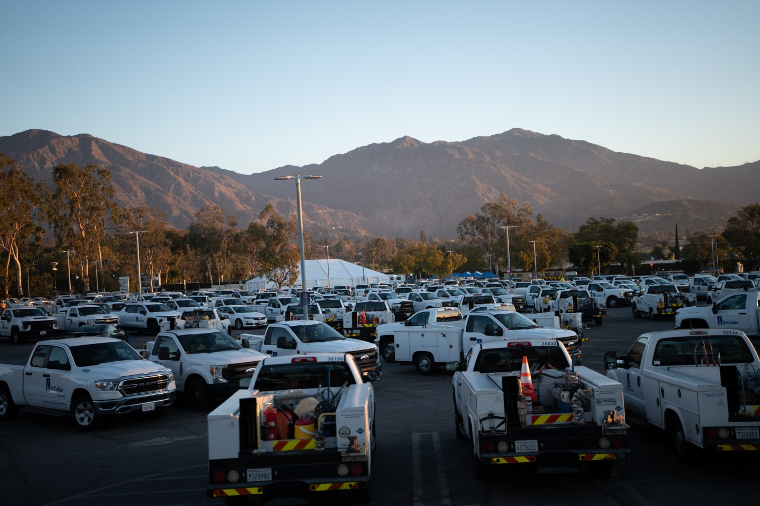
Eaton & Palisades Fire Response Efforts
Service Shutoffs, Assessments, Repairs, & Restorations
Mutual Aid Partners
Informational Booths
Community Meetings
Daily Factsheets

Slide 49
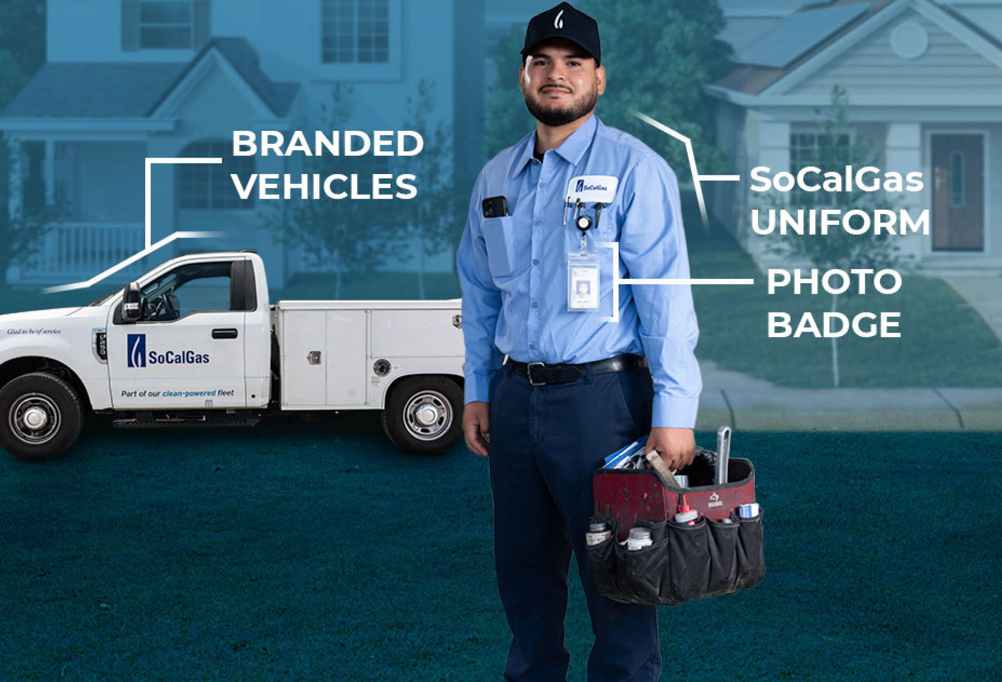
SoCalGas Infrastructure Resiliency
SCG Infrastructure
Meters
Gas leaks
Gas risers

Slide 50
To change out background image. Move overlay square, press delete, select icon and navigate to your image.
Emergency Information
www.SoCalGas.com/Fires
Report a leak 1(800)427-2200
Call 811 before you dig

Slide 51
Principal Management Analyst Mackenzie Bolger San Gabriel Valley Council of Governments
Chamber of Commerce | September 14, 2022
51

Slide 52
SGVCOG Regional Community Wildfire Protection Plan Update
March 1, 2025
Presented by
Mackenzie Bolger, Principal Management Analyst
Regional Planning & Programs

Slide 53
The SGVCOG is a subregional government agency that maximizes resources and promotes regional and member interests to improve the quality of life in the San Gabriel Valley.
Program Areas:
Homelessness
Housing
Sustainability & Environment
Transportation
Water

Slide 54
Regional Community Wildfire Protection Plan (CWPP)
Regional wildfire adaptation and prevention guiding document.
Hazards and risks analysis, potential projects in the SGV.
February 2023 - December 2025
Notes:
Overview of what a cwpp is

Slide 55
Why Develop a CWPP?
Education & Awareness
Coordinated Planning
Stakeholder Partnership
Future Funding for Projects
Notes:
Go over impetus for and purposes of a cwpp

Slide 56
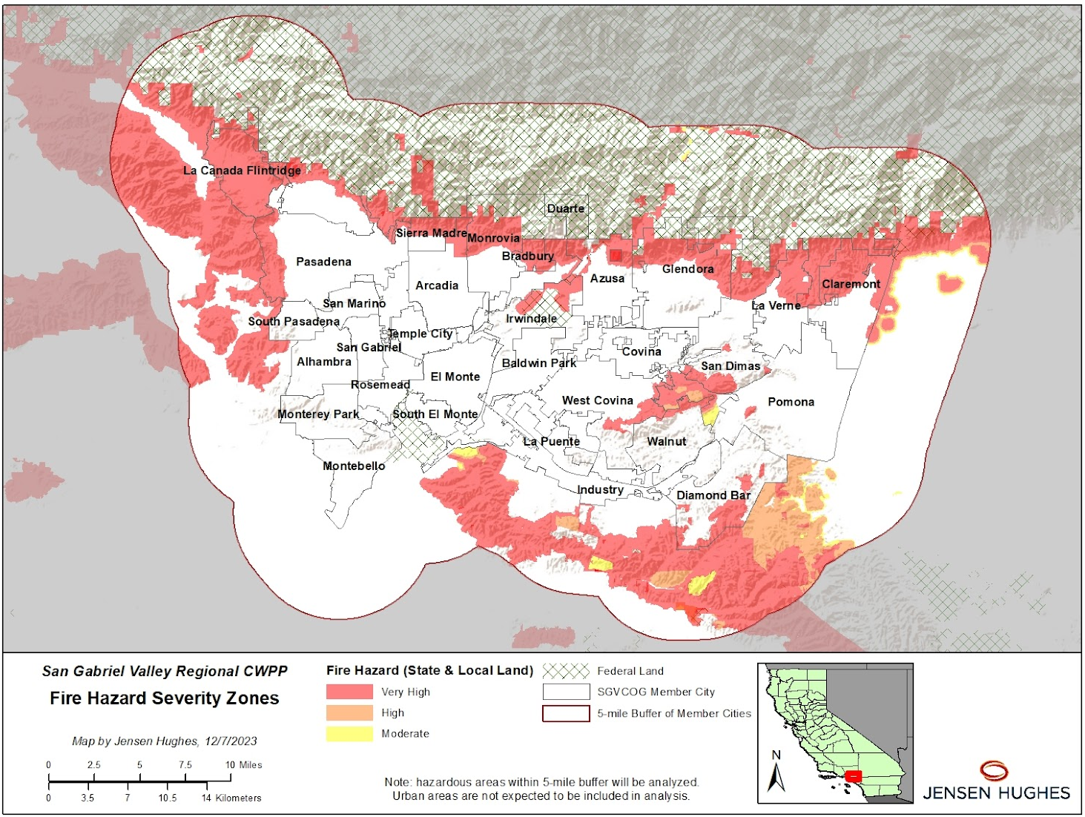
Notes:
overview of planning area

Slide 57
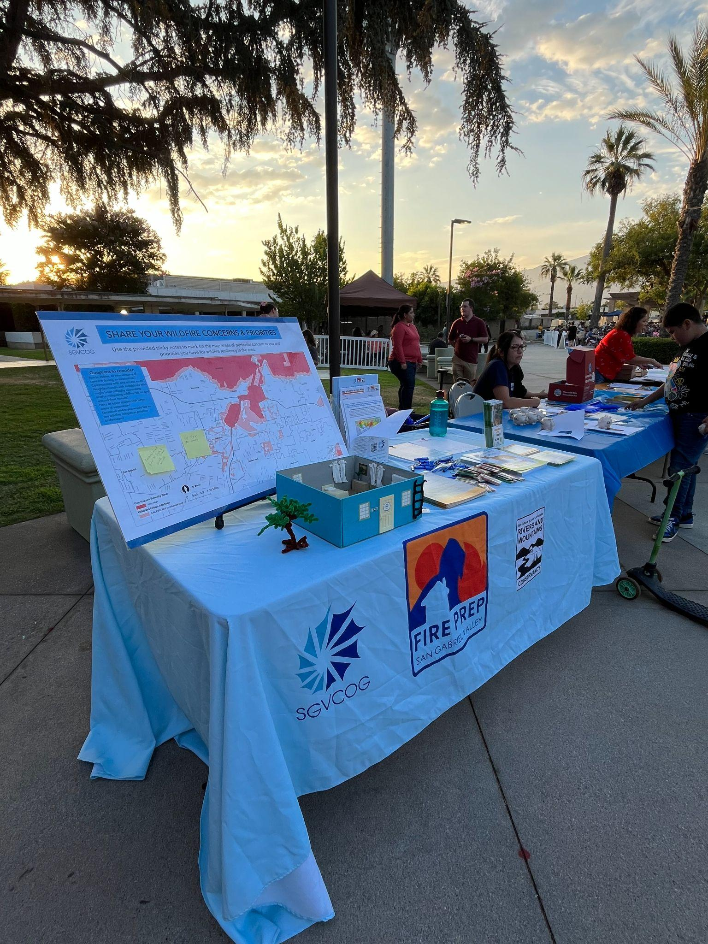
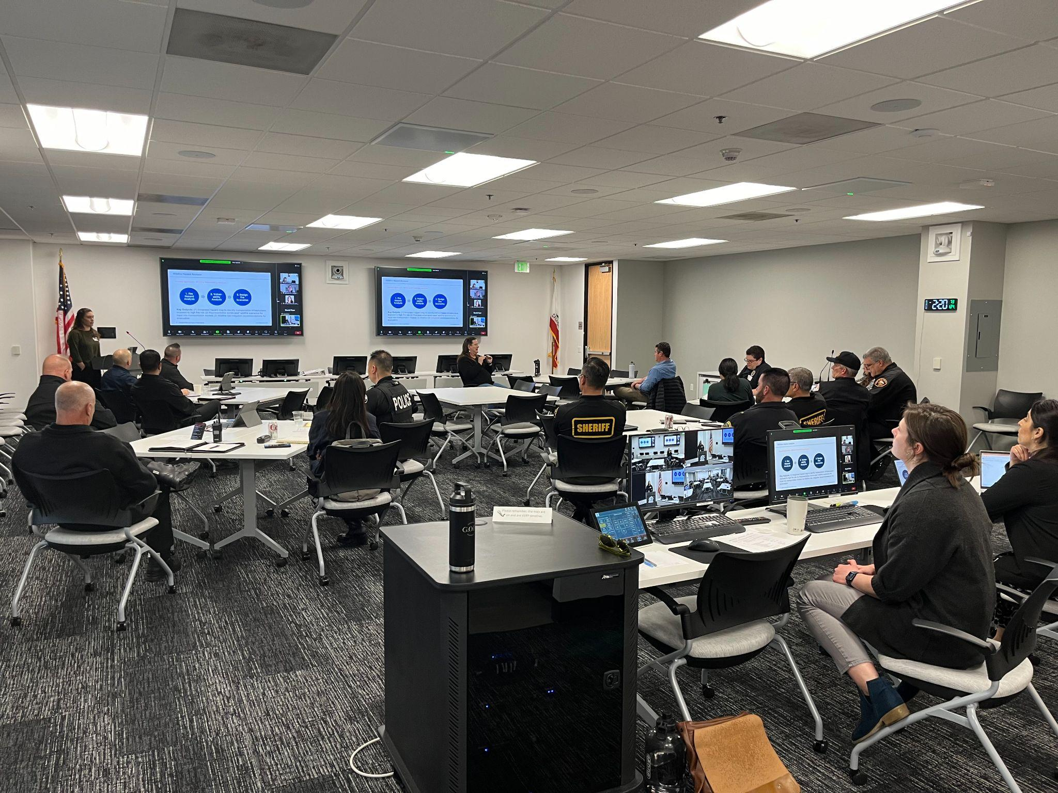
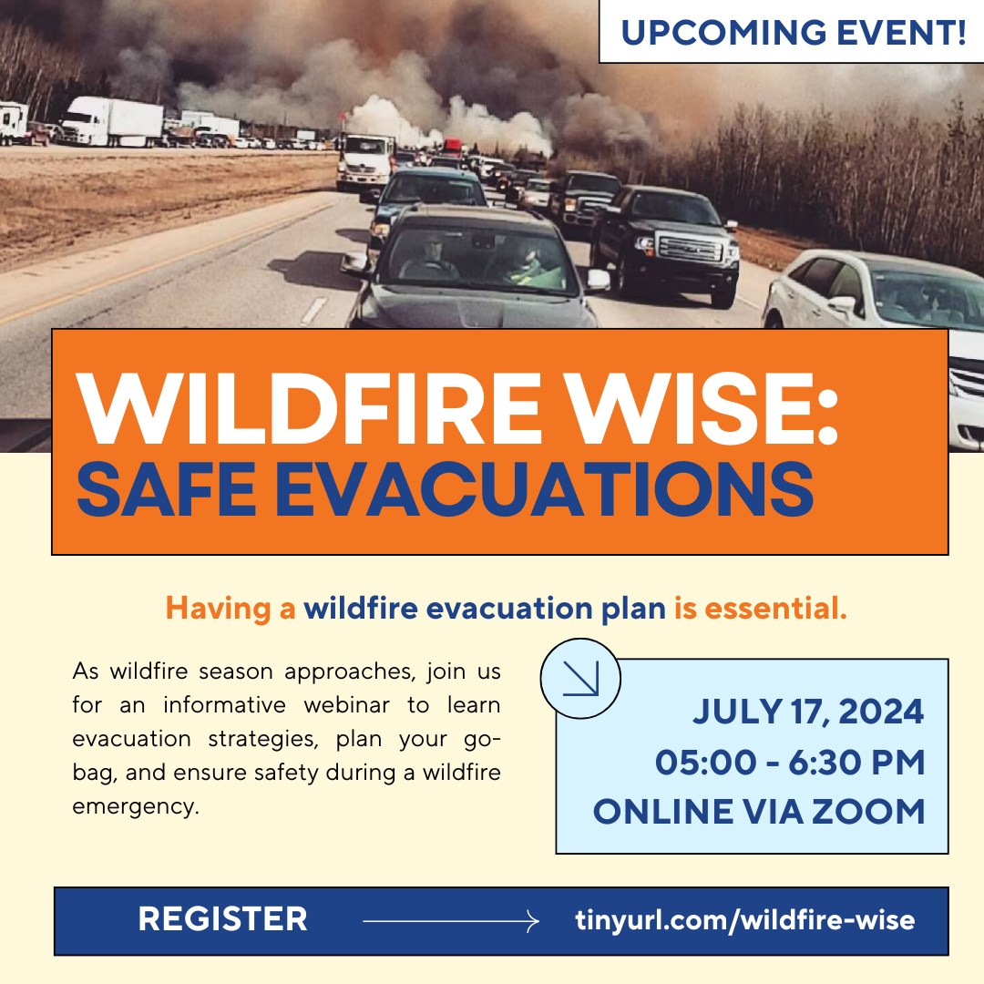
Outreach & Engagement
Notes:
How we are engaging stakeholders and the public
Bottom Right: FirePrep SGV and CWPP Virtual Event
Left: Technical Advisory Group (TAG) meeting
Below: CWPP Public Outreach in Irwindale

Slide 58
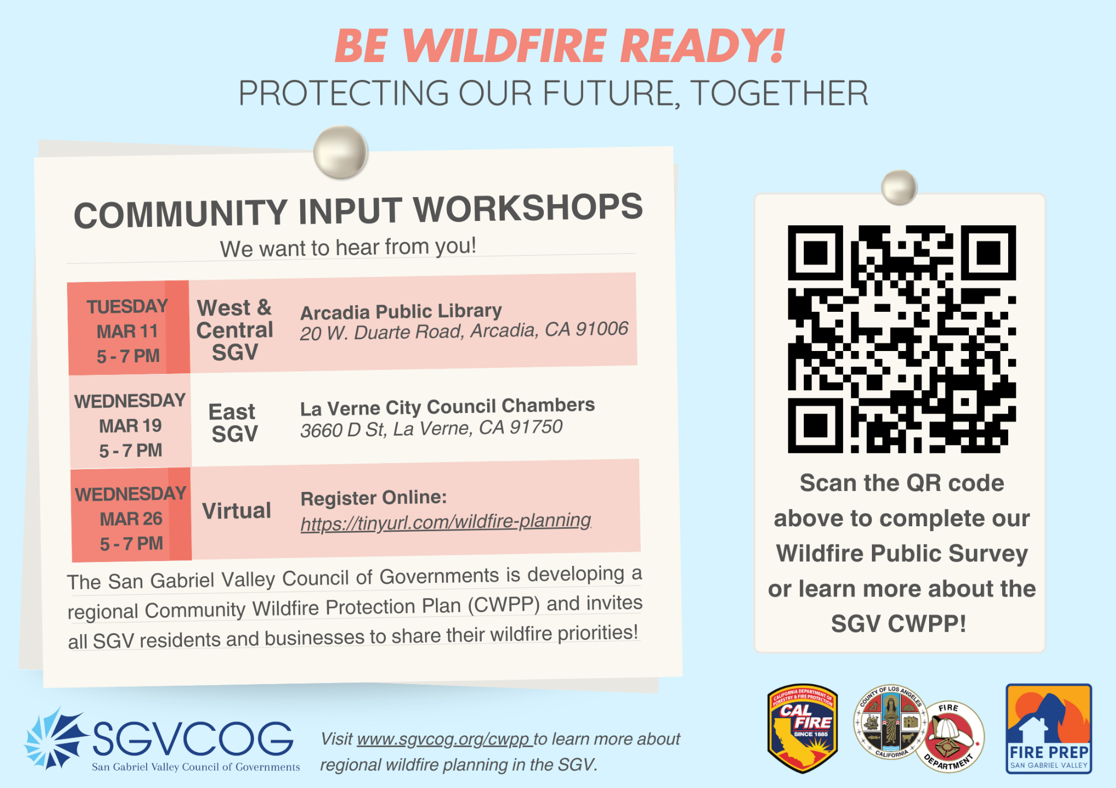
Looking Ahead
Community and Stakeholder Outreach
Draft for Public and Stakeholder Review
Submit for Approval
HH / DS Pilot Assessment Program
Notes:
More information about the workshops can be found on our website: https://www.sgvcog.org/wildfire
Registration to participate in our virtual workshop is: https://us06web.zoom.us/meeting/register/PutABZbZQbq7WVrE5tOXMg#/registration

Slide 59
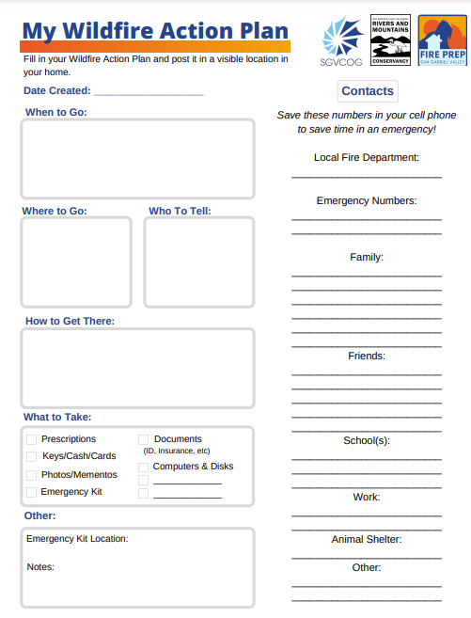
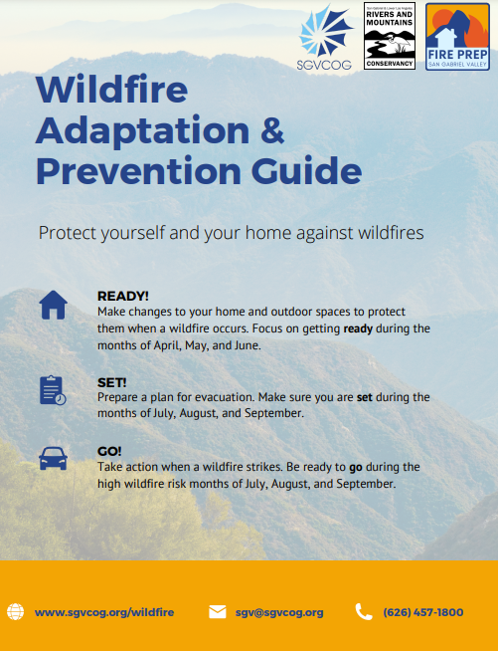
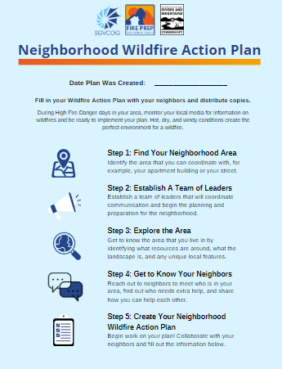
Fire Prep SGV
sgvcog.org/wildfire
Notes:
Serves as an avenue to help communities to mitigate, prevent, and prepare for wildfires in the region.
Supports FDs w/ limited capacity to provide outreach to residents.
Provide wildfire prevention and adaptation education, specifically communities located in Very High Fire Hazard Severity Zones (VHFHSZ) in SGVCOG’s jurisdiction.Wildfire Materials focused on home hardening, defensible space, evacuation preparedness, creating household and neighborhood action plans, preparing your pets, and mental health resources for during and post-fire recovery.

Slide 60
For More Information
Mackenzie Bolger, Principal Management Analyst
Regional Planning & Programs
mbolger@sgvcog.org
626-214-1316
sgvcog.org/wildfire

Slide 61
PUBLIC COMMENT
As this is a special meeting, the City Council has set aside this time for persons who wish to comment specifically on topics related to this agenda. Each speaker will have up to three minutes to speak.
Public Comment Follow Up Please Email:
contact@claremontca.gov
Chamber of Commerce | September 14, 2022
61

Slide 62
Questions?
Chamber of Commerce | September 14, 2022

Slide 63
RECESS
The special meeting of the Claremont City Council is currently in recess.
Chamber of Commerce | September 14, 2022
63

Slide 64
STAFF RESPONSES
Staff responses to questions raised during public comment.
Chamber of Commerce | September 14, 2022
64

Slide 65
City Council Closing Comments
Chamber of Commerce | September 14, 2022
65

Slide 66
ADJOURNMENT
The next regular City Council Meeting will be held on
March 11, 2025.
Chamber of Commerce | September 14, 2022
66

